Slide 1

Influence of West Asia crisis on Indian Economy
Chenchu Aravind- 20MIA1126
SHAIK SAHEER AHMED-20MIA1143
SAPTHARISHEE-20MIA1150

Slide 2

Introduction
The West Asia crisis, characterized by geopolitical tensions, economic challenges, has emerged as a pivotal factor with profound implications for the global economy.
As tensions escalate and uncertainties unfold, the repercussions are felt far beyond the geographical confines of the region.
Understanding the potential impact on the Indian economy becomes paramount. India, as one of the world's fastest-growing economies and a significant player in the global market, stands at the intersection of various economic forces.

Slide 3
Data Source:
https://databank.worldbank.org/source/escap-world-bank:-international-trade-costs/Type/TABLE/preview/on
The data is sourced from the World Bank's World Development Indicators (WDI) database.
The WDI database is considered to be the primary source of global development data, providing national, regional, and global estimates.

Slide 4

Datasets
Country Name: The name of the country.
Year: The year for which the data is recorded.
Exports of goods and services (% of GDP): The percentage of GDP represented by exports of goods and services.
Food exports (% of merchandise exports): The percentage of merchandise exports represented by food exports.
Fuel imports (% of merchandise imports): The percentage of merchandise imports represented by fuel imports.
GDP growth (annual %): The annual percentage growth rate of the GDP.
High-technology exports (% of manufactured exports): The percentage of manufactured exports represented by high-technology exports.
Inflation, GDP deflator (annual %): The annual percentage change in the GDP deflator.
Inflation, consumer prices (annual %): The annual percentage change in consumer prices.
Military expenditure (% of GDP): The percentage of GDP represented by military expenditure.
Trade (% of GDP): The percentage of GDP represented by trade.
Trade in services (% of GDP): The percentage of GDP represented by trade in services.

Slide 5
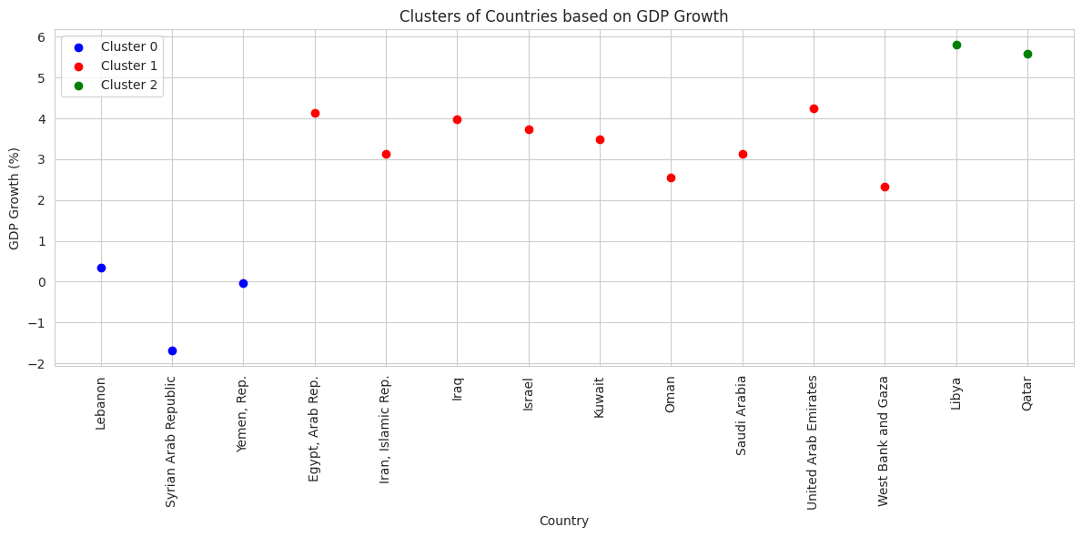

Slide 6
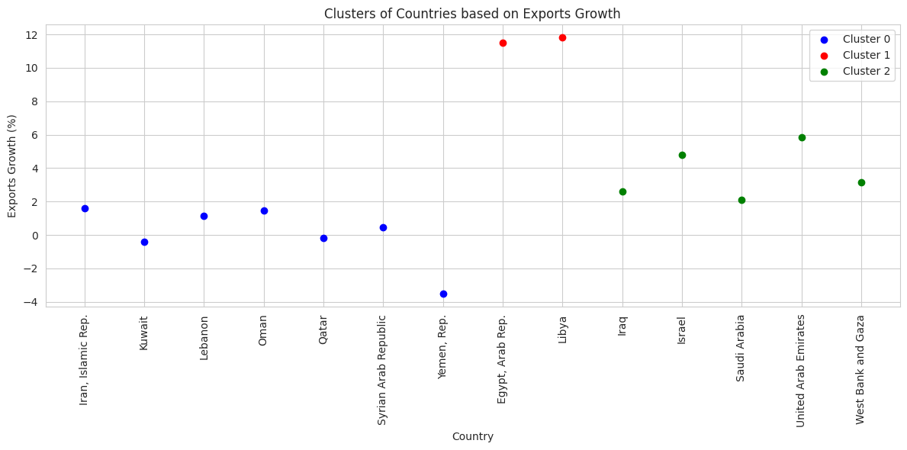

Slide 7
Methodology
Data Sources: Gathered economic indicators datasets for India and West Asian countries.
Merged Datasets: Combined datasets based on the year column to create a unified dataset.
Exploratory Data Analysis (EDA): Conducted descriptive statistics and clustering analysis on GDP growth and exports growth.
Regression Analysis: Utilized linear regression to understand the relationship between West Asian economic indicators and India's GDP growth.
Machine Learning Models: Employed advanced models including LSTM, BiLSTM, GRU, BiGRU, Random Forest, and Gradient Boosting to predict India's GDP growth and assess feature importance.

Slide 8
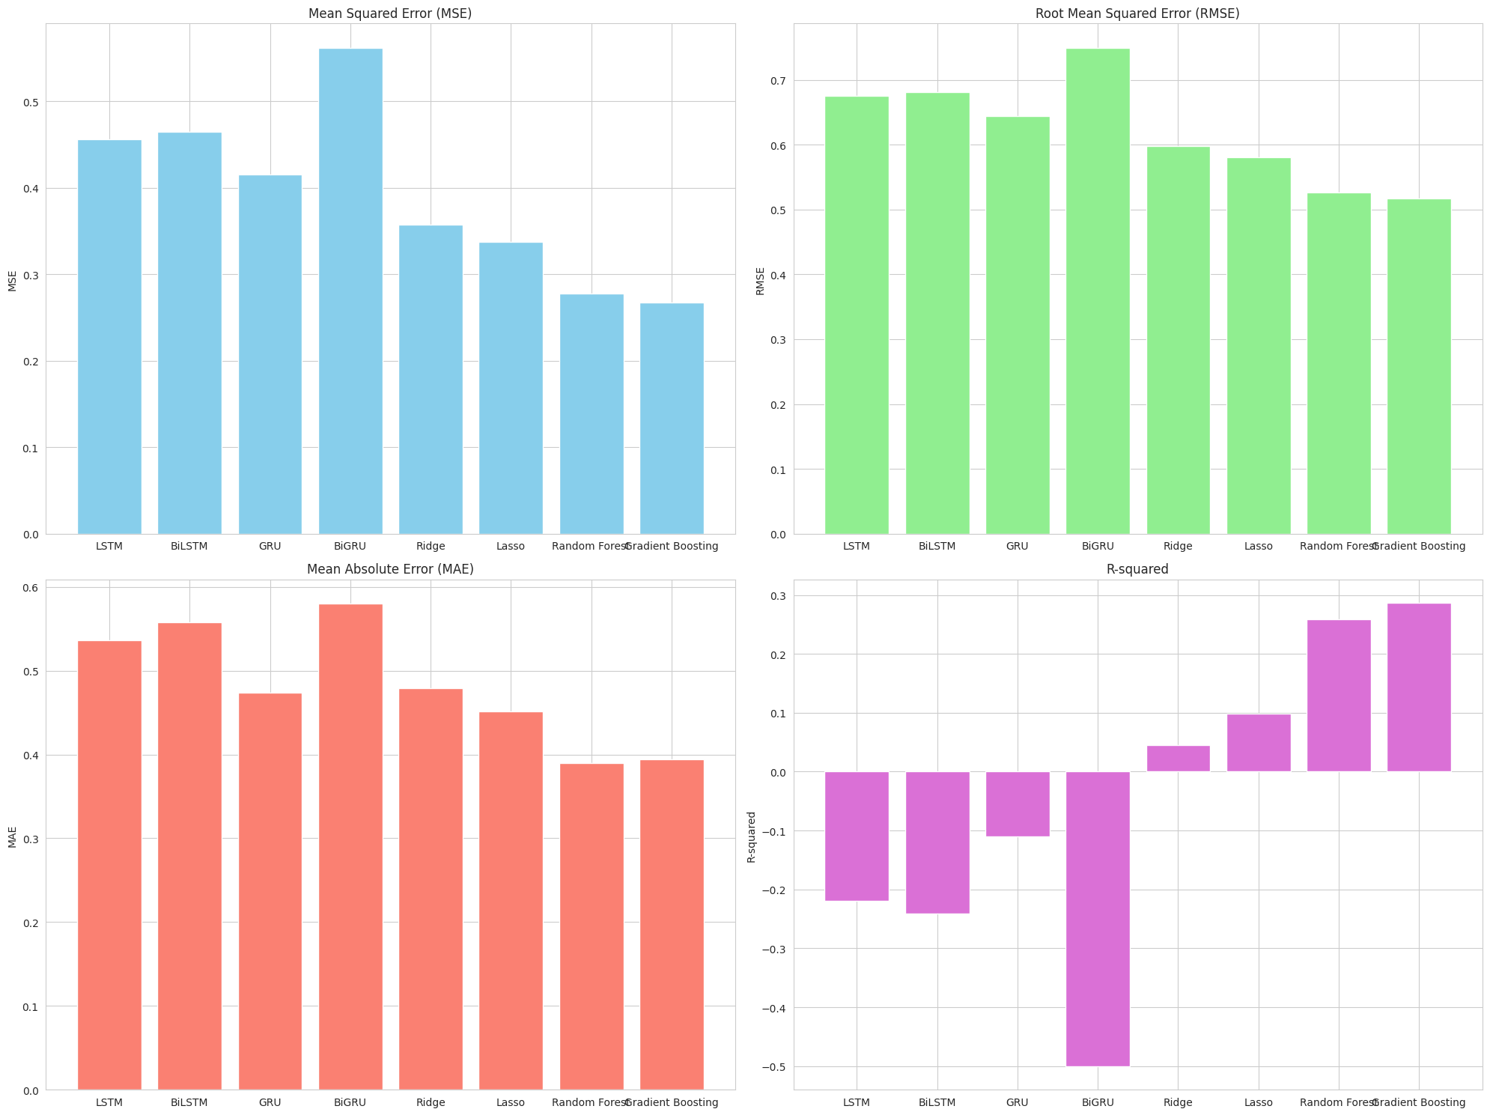

Slide 9
Inference:
Modest Model Fit: Linear regression showed a limited predictive accuracy (R-squared: 0.0446), indicating a need for more complex models to capture the nuanced impacts of West Asian economies on India.
GRU as the Strong Performer: Among advanced models, the GRU model showed relatively better performance with lower error metrics (MSE: 0.4153, R-squared: -0.1096) than LSTM and BiLSTM models, suggesting a better fit for capturing underlying data patterns.
Challenges with Complex Models: BiLSTM and BiGRU models demonstrated poorer fits (R-squared: -0.2410 and -0.5007, respectively), indicating that added complexity does not necessarily translate to better predictive power for this dataset.

Slide 10

Inferences
Inflation GDP deflator and trade volumes were identified as significant predictors, suggesting these factors should be closely monitored for forecasting India’s economic responses to West Asian dynamics.
Effective monitoring and analysis of trade and inflation metrics can provide crucial insights for policy-making, helping to stabilize or leverage economic outcomes amid regional economic fluctuations.

Slide 11
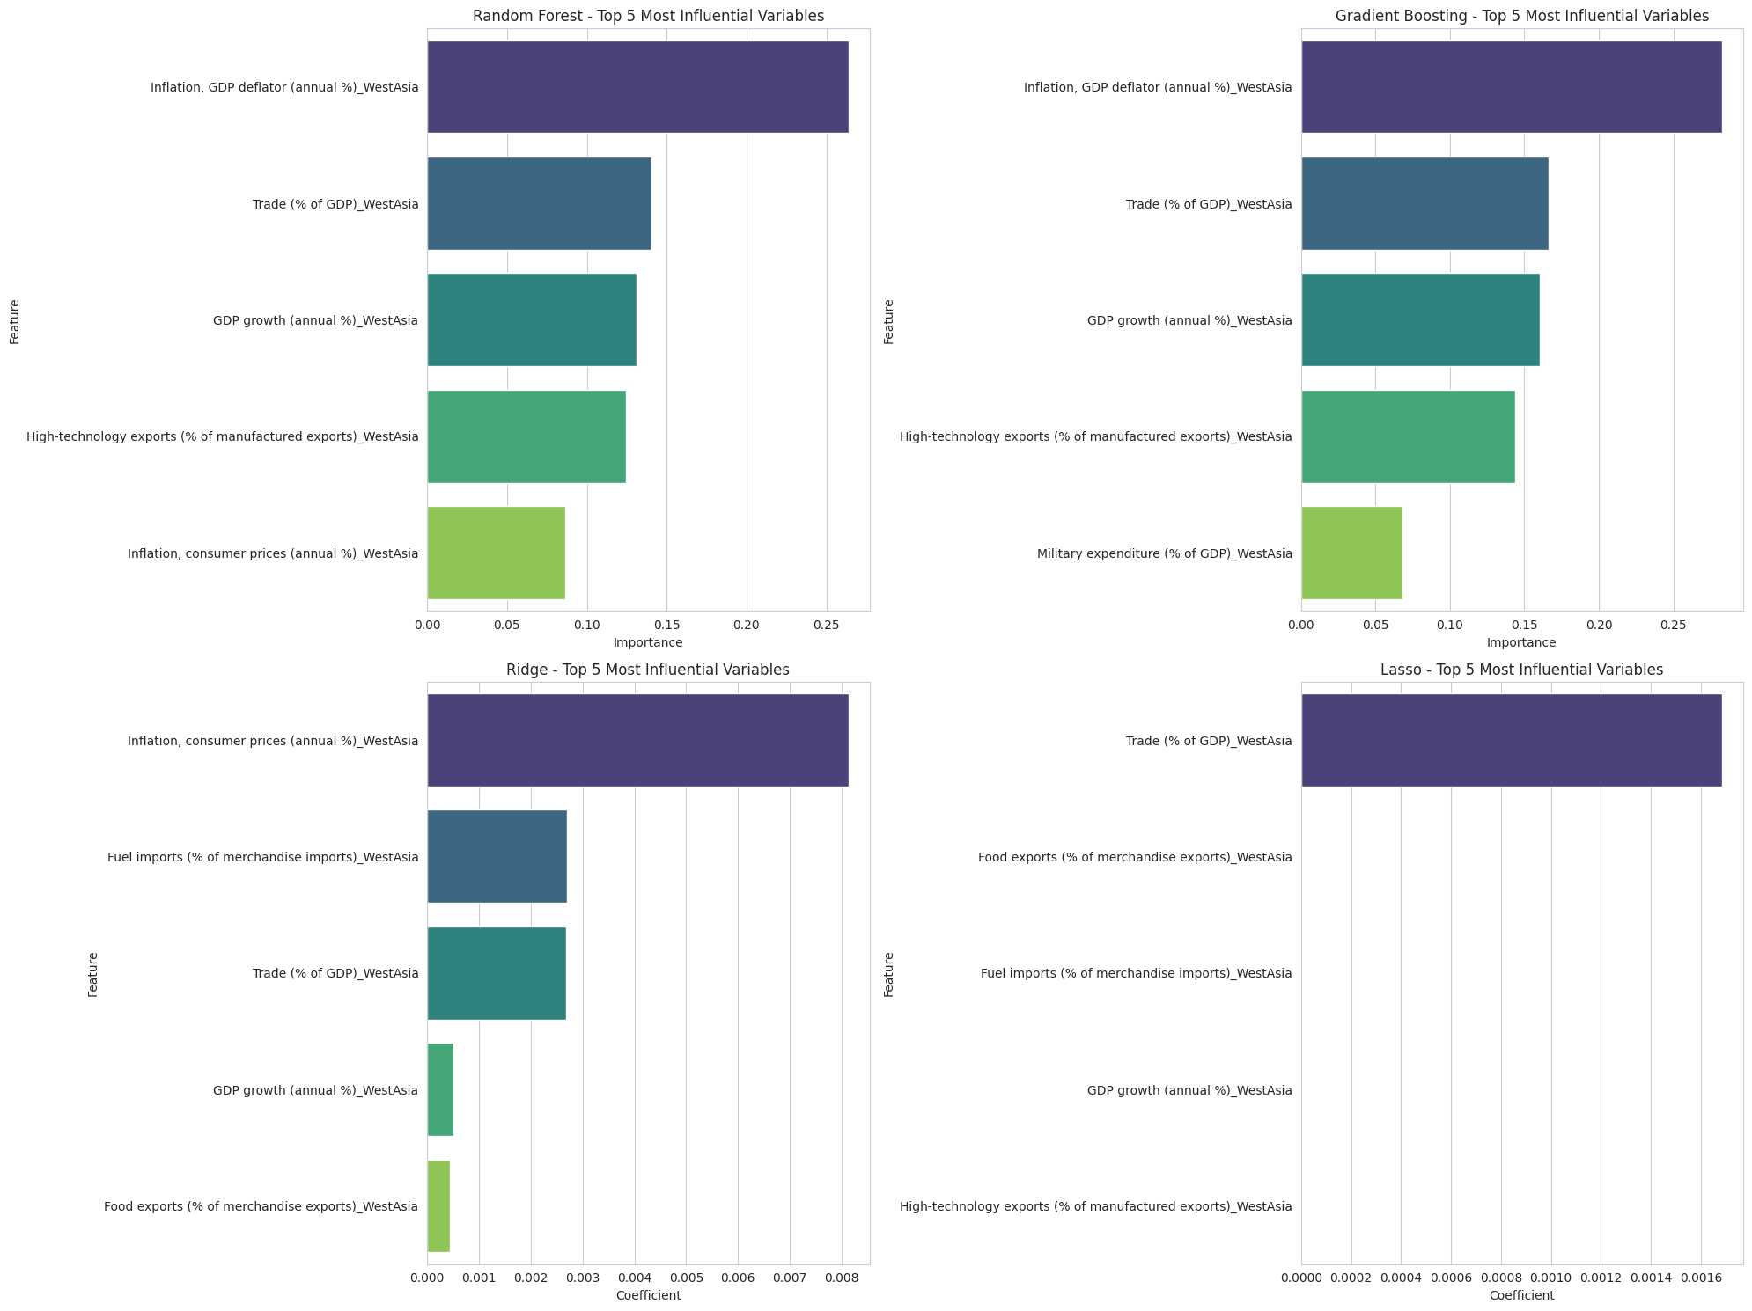

Slide 12

Conclusion
Linear regression provided a foundational understanding but had limited predictive accuracy.
Among the advanced models, the GRU (Gated Recurrent Unit) model demonstrated better performance relative to LSTM, BiLSTM, and BiGRU models, though its R-squared still indicated room for improvement.
Inflation rates (GDP deflator) and trade volumes emerged as significant predictors in modeling efforts.
The significance of these indicators also suggests that economic stability or fluctuations in West Asia, particularly in terms of trade and inflation, have noticeable ripple effects on India's economy.

